Slide 1
OPENAI – GYM
By: Akshat Mehrotra

Slide 2
ENVIRONMENTS
There are many environments in OpenAI and categorized in three major parts:
Environments packaged with GYM :
ALGORITHMIC : Allows you to perform algorithmic tasks.
ATARI : Allows you to use various games developed by Atari.
Box2D : it is a 2D physics engine.
etc.
Environments packaged with OpenAI:
Gym-RETRO : Allows user to turn classic video games into Gym environments for reinforcement learning. Uses LibertoAPI for fast integration.
RoboSchool : 3D physics environment which is open-sourced and uses Bullet physics engine.
etc.
Third Party Environments
OBSTACLE TOWER : 3D generated tower using physics.
PGE : Allows AI simulations, uses Bullet physics.
GYM-MAZE : A simple 2D maze environment where agent finds way from start to end.

Slide 3
TIC TAC TOE – OpenAI Gym
Install the API by : pip install gym-tictactoe
Base dependency : gym
Plot-rendering dependencies : numpy, matplotlib
DQN dependencies : tensorflow, numpy
Environments supported currently :
tictactoe-v0
tictactoe-plot-v0

Slide 4
Understanding the Code
The implementation of the game is in 3 dimensions.
The textual environment displays the 3 matrices side by side for better understanding.
Understanding the code:
First, initialize the environment : gym.make(‘tictactoe-v0’)
Define a set of actions to performed. These actions are strings of length 4. [‘a’, ‘b’, ‘c’, ‘d’].
‘a’ : takes values 1 (representing ‘X’) and 2 (representing ‘o’).
‘b’ : specifies which matrix to enter out of the three. These matrices can bethought of 3X3 matrices similar to an RGB image in structure. R being matrix 1, G being the second and B being the third. Takes values 0, 1 or 2.
‘c’ : Specifies the column to traverse to in the specified matrix. Takes values 0, 1 or 2.
‘d’ : Specifies the row to traverse to in the column of the specified matrix. Takes value 0,1 or 2.
The action strings can be thought of to be divided in two parts : first, the character you want to put. Second the position of the character (which is a length 3 string).
Ex : [‘1021’] denotes –
1 → character is ‘X’. (character)
0 → go to the first matrix out of the three. (position of the cell)
2 → go to the third column of the matrix. (position of the cell)
1 → go to the second row of the column (position of the cell)

Slide 5


Snippets from the code to understand the action strings
Action = [‘1021’]
Action = [‘2111’]

Slide 6
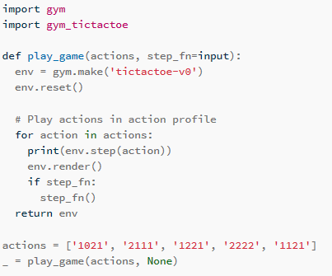
Code
Calling the environment
Snippet
First, call the environment.
Calling and resetting the environment returns the algorithm with Q-learning.
Provide a list of actions that you want to perform, ie, defining the placements of the X or O.
Loop over the action list’s elements and for each element render the environment and if the input is passed loop it again.

Slide 7
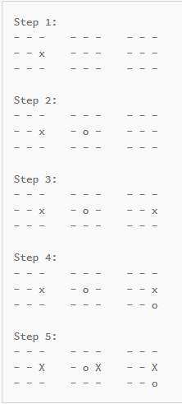
OUTPUT OF THE ALGORITHM
The winning sequence is achieved at step 5.

